Slide 1
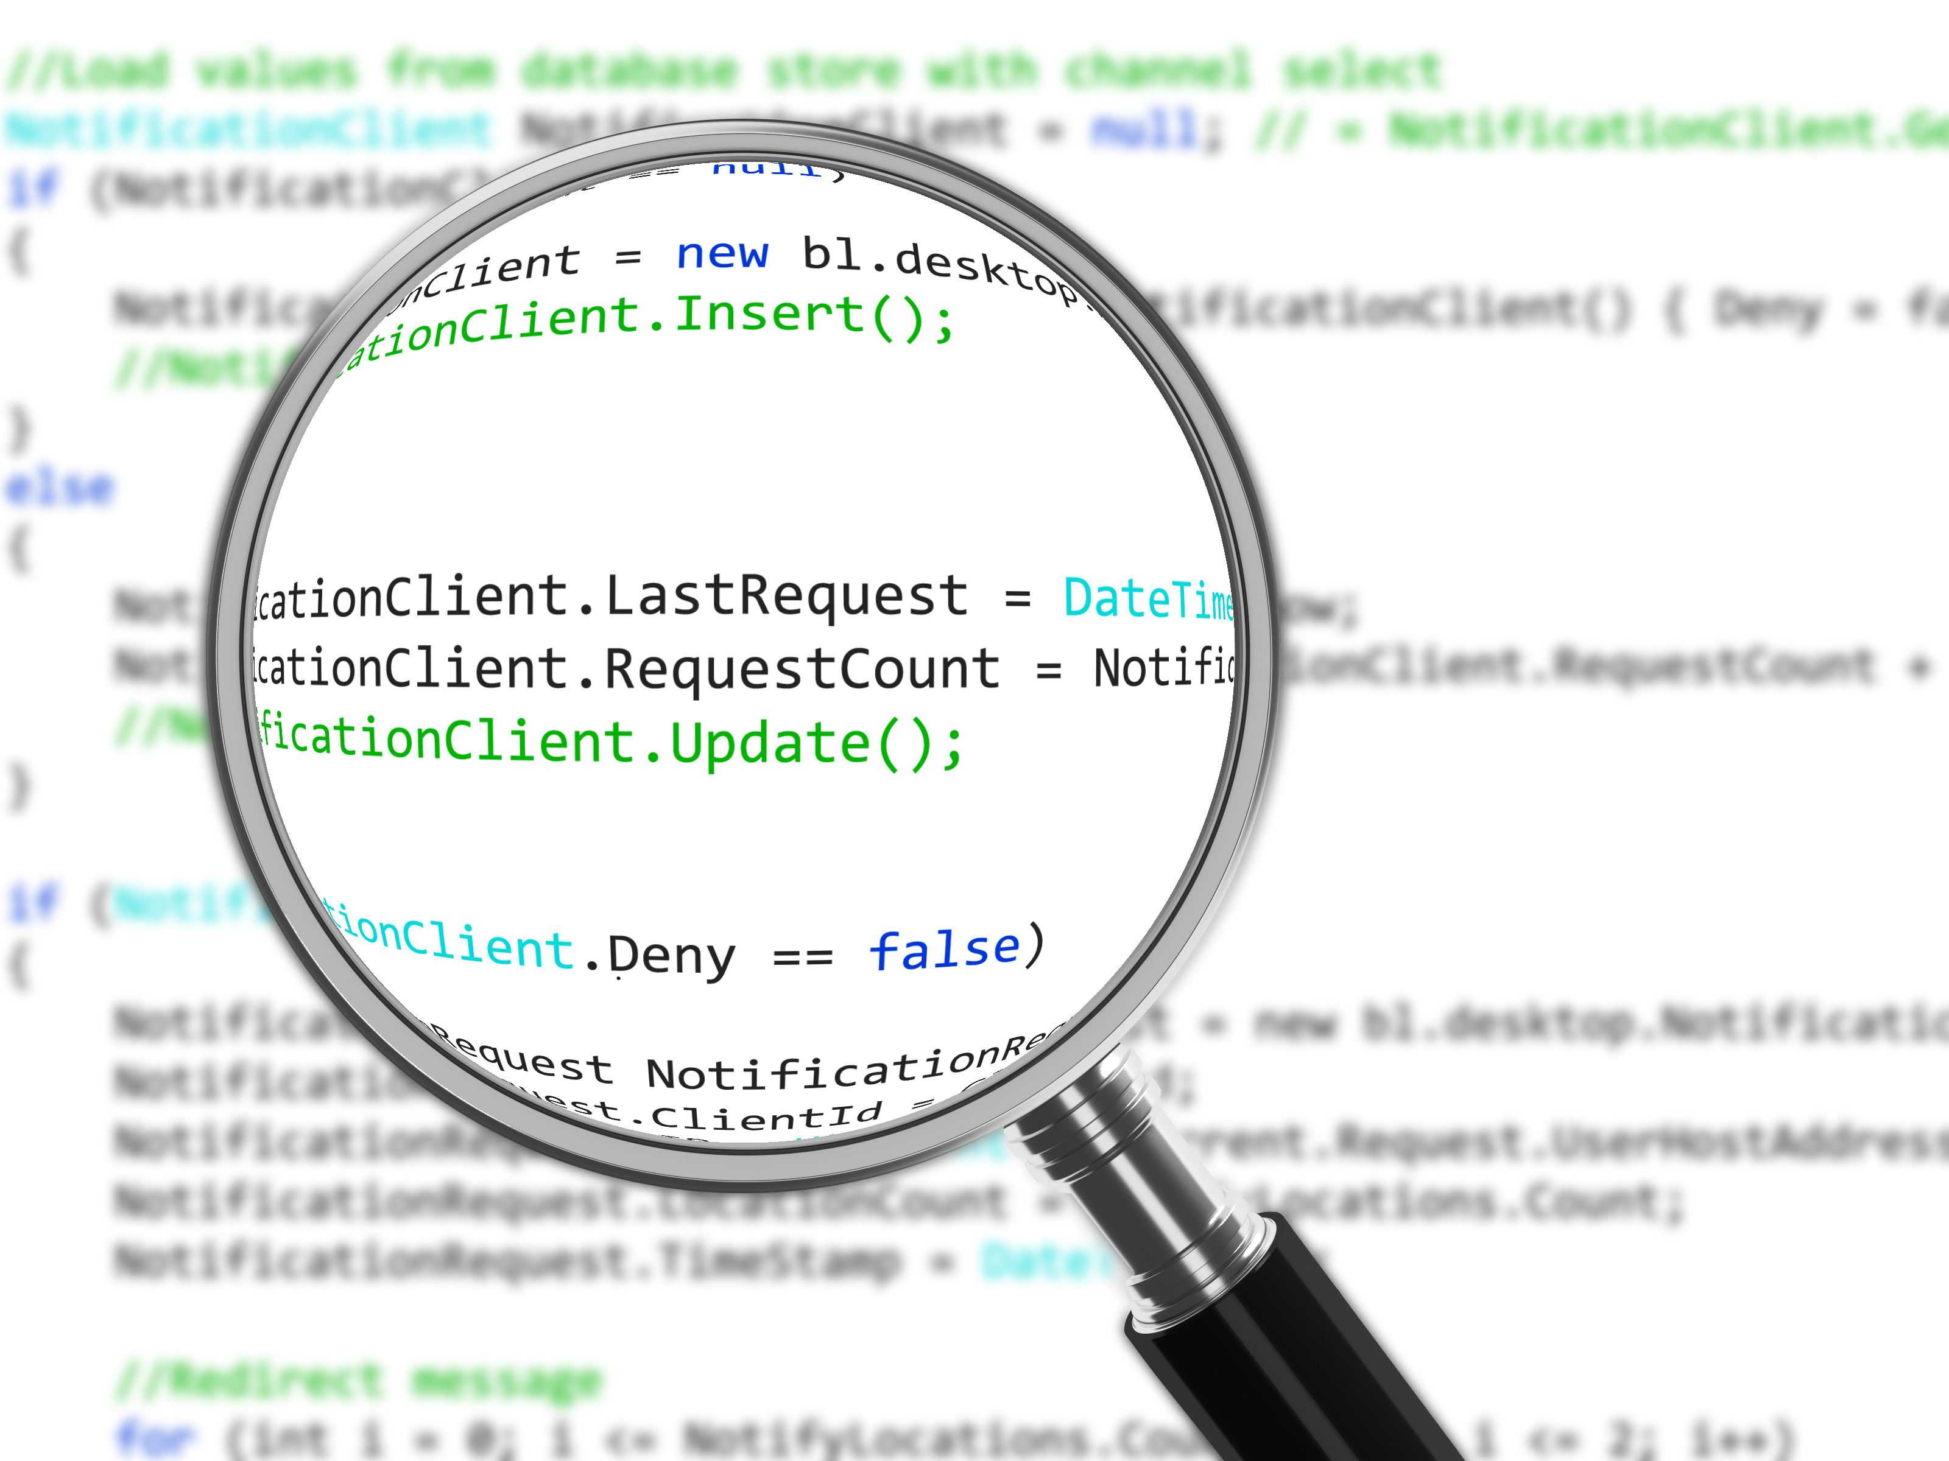
Conquering Uncomfortable Code Reviews
Patrick Schwisow
Madison PHP Conference—November 14, 2015

Slide 2
What is a Code Review?
“Code review is systematic examination…of computer source code.
It is intended to find and fix mistakes overlooked in the initial development phase,
improving both the overall quality of software and the developers’ skills.”
(http://en.wikipedia.org/w/index.php?title=Code_review&oldid=530204872)

Slide 3
Who does Code Reviews?
Peers (other developers)
Managers / Team Leads / Senior Developers
Dedicated QA / Testing Personnel
All of the above

Slide 4
Code Reviews in Your Workflow
Code review is a required step
Review as soon as possible
Functional testing—together or separate?
Include reviews in all estimation

Slide 5
Code Review Prerequisites
Issue Tracking
JIRA
Trac
GitHub Issues
Version Control System
Git
Mercurial
Subversion

Slide 6
Code Review Tools
GitHub Pull Requests
Bitbucket Pull Requests
Atlassian Stash
Atlassian Crucible
Review Board
Anything that gives you a diff

Slide 7

Getting Ready
Agree on process
Agree on standards
Automate where possible
Plan for disagreements
Everything is subject to future re-evaluation
Notes:
Process
How do you choose a code reviewer?
How do you track status and keep it moving?
Standards (Code style, Architecture, Testing)
Automate
Save the humans for things that require judgment
Tools to validate and tools to correct
Disagreements == “How to break a tie”

Slide 8
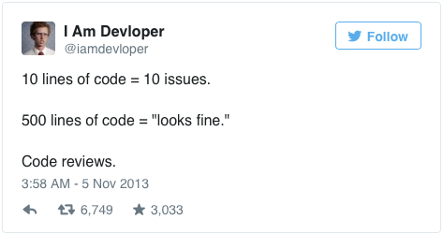
Rules of Code Reviews
Review ALL the changes.

Slide 9
Rules of Code Reviews
Review all the agreed upon criteria
Functionality
Architecture
Efficiency
Code style
Readability

Slide 10

Rules of Code Reviews
If it looks wrong, ASK!!!
If you are unsure, ASK!!!
Not all comments / questions require a code change.

Slide 11

Rules of Code Reviews
It’s OK not to say anything.

Slide 12
Rules of Code Reviews
Correct is good enough.
Facts are better than opinions.
Be specific.
Cite sources whenever possible.
Discuss “off-line” if needed, but document the resolution.
Notes:
It doesn’t have to be exactly how you would write it.
Opinions are still valuable, but facts should be your first choice.
Facts are less likely to be received negatively.
When you cite sources, you are the messenger not the judge.

Slide 13

Rules of Code Reviews
What is missing?
Completeness
Consistency
Error handling
Edge cases
Test coverage
Documentation
Side effects?

Slide 14
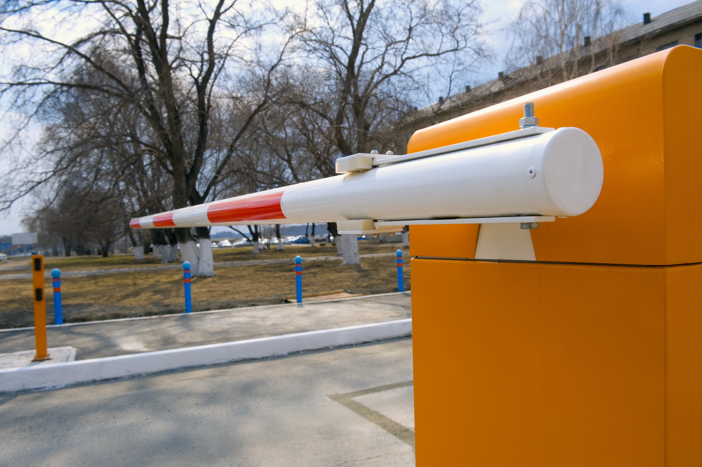
Rules of Code Reviews
Nothing goes to prod until it’s been reviewed.
Nothing goes to prod until it’s been tested.

Slide 15

Rules of Code Reviews
If it’s out of scope, create a ticket.
Notes:
Don’t sweep it under the rug.
Watch out for scope creep.

Slide 16

Rules of Code Reviews
“Don’t see code reviews as attacks on your person. They are lessons.”
–Stefan Koopmanschap
Wisdom of the ElePHPant
wisdomoftheelephpant.com
Notes:
This goes for both sides, the developer and the reviewer.
Don’t make it personal when you write.
Don’t take it personally when you read.
Code reviews should be a positive experience for both parties.

Slide 17
Recommended Reading
Mark Chu-Carroll: Things Everyone Should Do: Code Review
Jeff Atwood: Code Reviews: Just Do It
Steve McConnell: Code Complete: A Practical Handbook of Software Construction (http://amzn.com/0735619670)
Karl Wiegers: Peer Reviews in Software: A Practical Guide (http://amzn.com/0201734850)

Slide 18

Who Am I? Feedback / Contact / Slides
Software Engineer at Shutterstock
Zend Certified Engineer – PHP 5 & Zend Framework
Founder / Organizer of Lake / Kenosha PHP
Email: patrick.schwisow@gmail.com
Twitter: @Pschwisow
Slides: https://github.com/PSchwisow/Miscellaneous/
Joind.in: https://joind.in/talk/view/16017
Notes:
Images courtesy of Shutterstock (with the exception of skoop’s Twitter avatar)
We are hiring!

